Slide 1
SD

Slide 2
Story Points
How many trips have been recorded total during the chosen period?
By what percentage has total ridership grown?
How has the proportion of short-term customers and annual subscribers changed?
What are the peak hours in which bikes are used during summer months?
What are the peak hours in which bikes are used during winter months?
Today, what are the top 10 stations in the city for starting a journey? (Based on data, why do you hypothesize these are the top locations?)
Today, what are the top 10 stations in the city for ending a journey? (Based on data, why?)
Today, what are the bottom 10 stations in the city for starting a journey? (Based on data, why?)
Today, what are the bottom 10 stations in the city for ending a journey (Based on data, why?)
Today, what is the gender breakdown of active participants (Male v. Female)?
How effective has gender outreach been in increasing female ridership over the timespan?
How does the average trip duration change by age?
What is the average distance in miles that a bike is ridden?
Which bikes (by ID) are most likely due for repair or inspection in the timespan?
How variable is the utilization by bike ID?
Additionally, city officials would like to see the following visualizations:
A static map that plots all bike stations with a visual indication of the most popular locations to start and end a journey with zip code data overlaid on top.
If you're working with a merged dataset: a dynamic map that shows how each station's popularity changes over time (by month and year) -- with commentary pointing to any interesting events that may be behind these phenomena.
Lastly, as a chronic over-achiever:
Find at least two unexpected phenomena in the data and provide a visualization and analysis to document their presence.

Slide 3
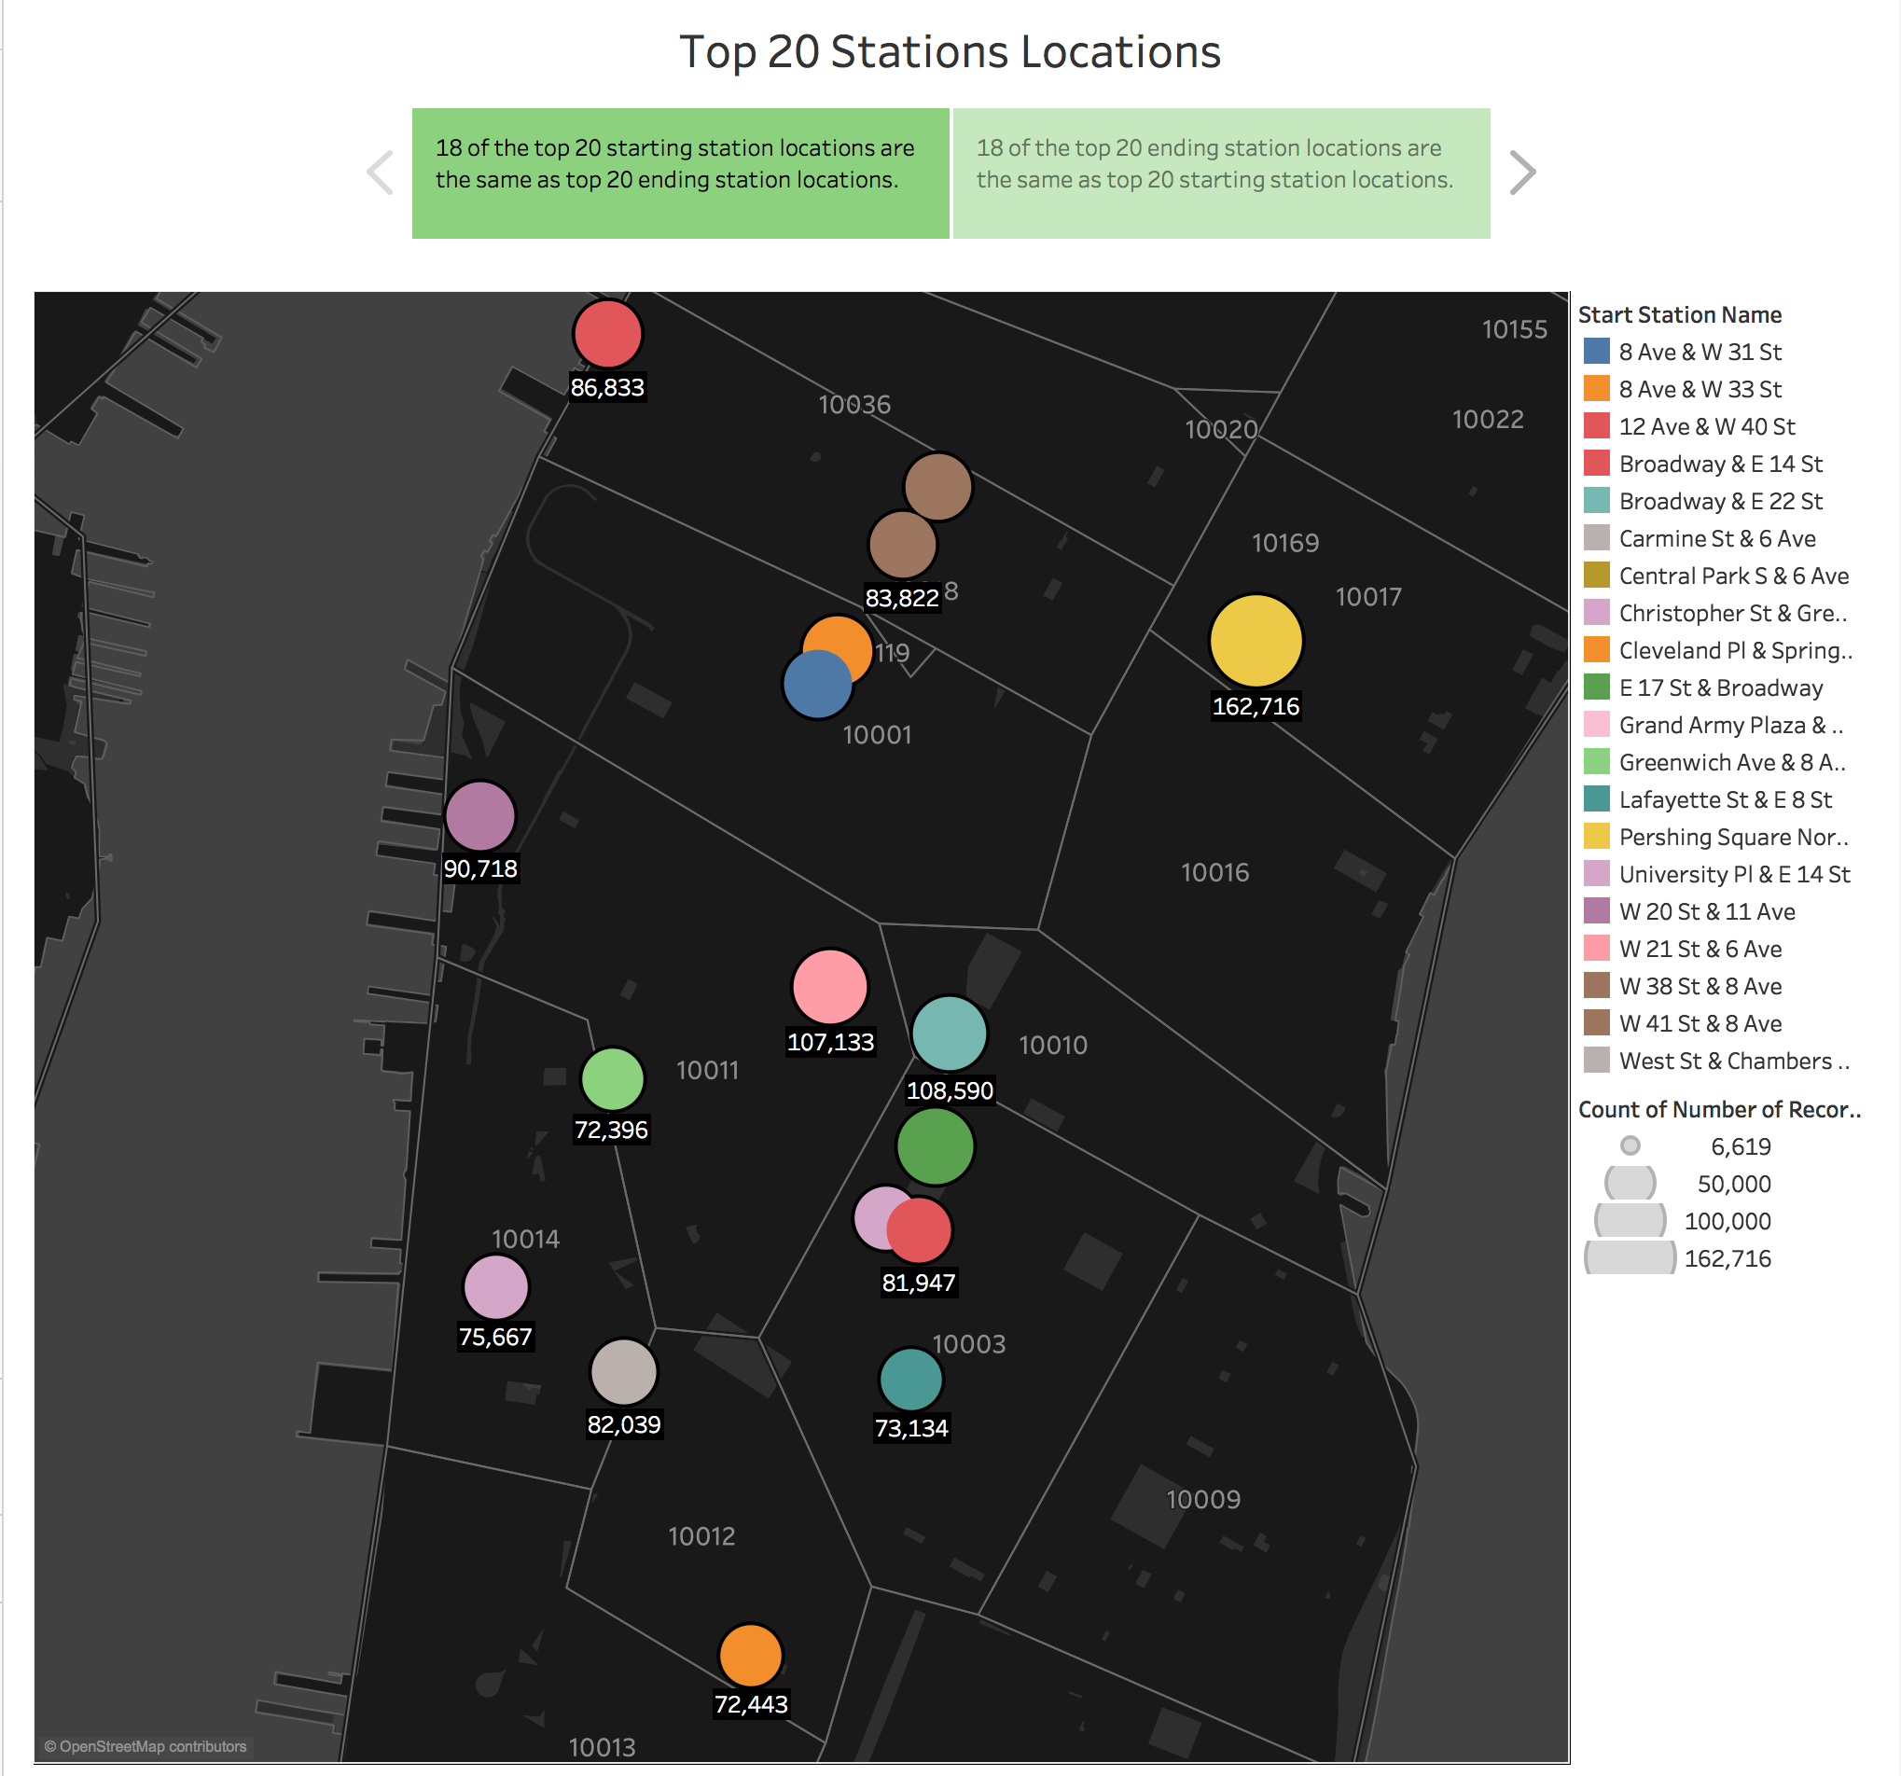

Slide 4
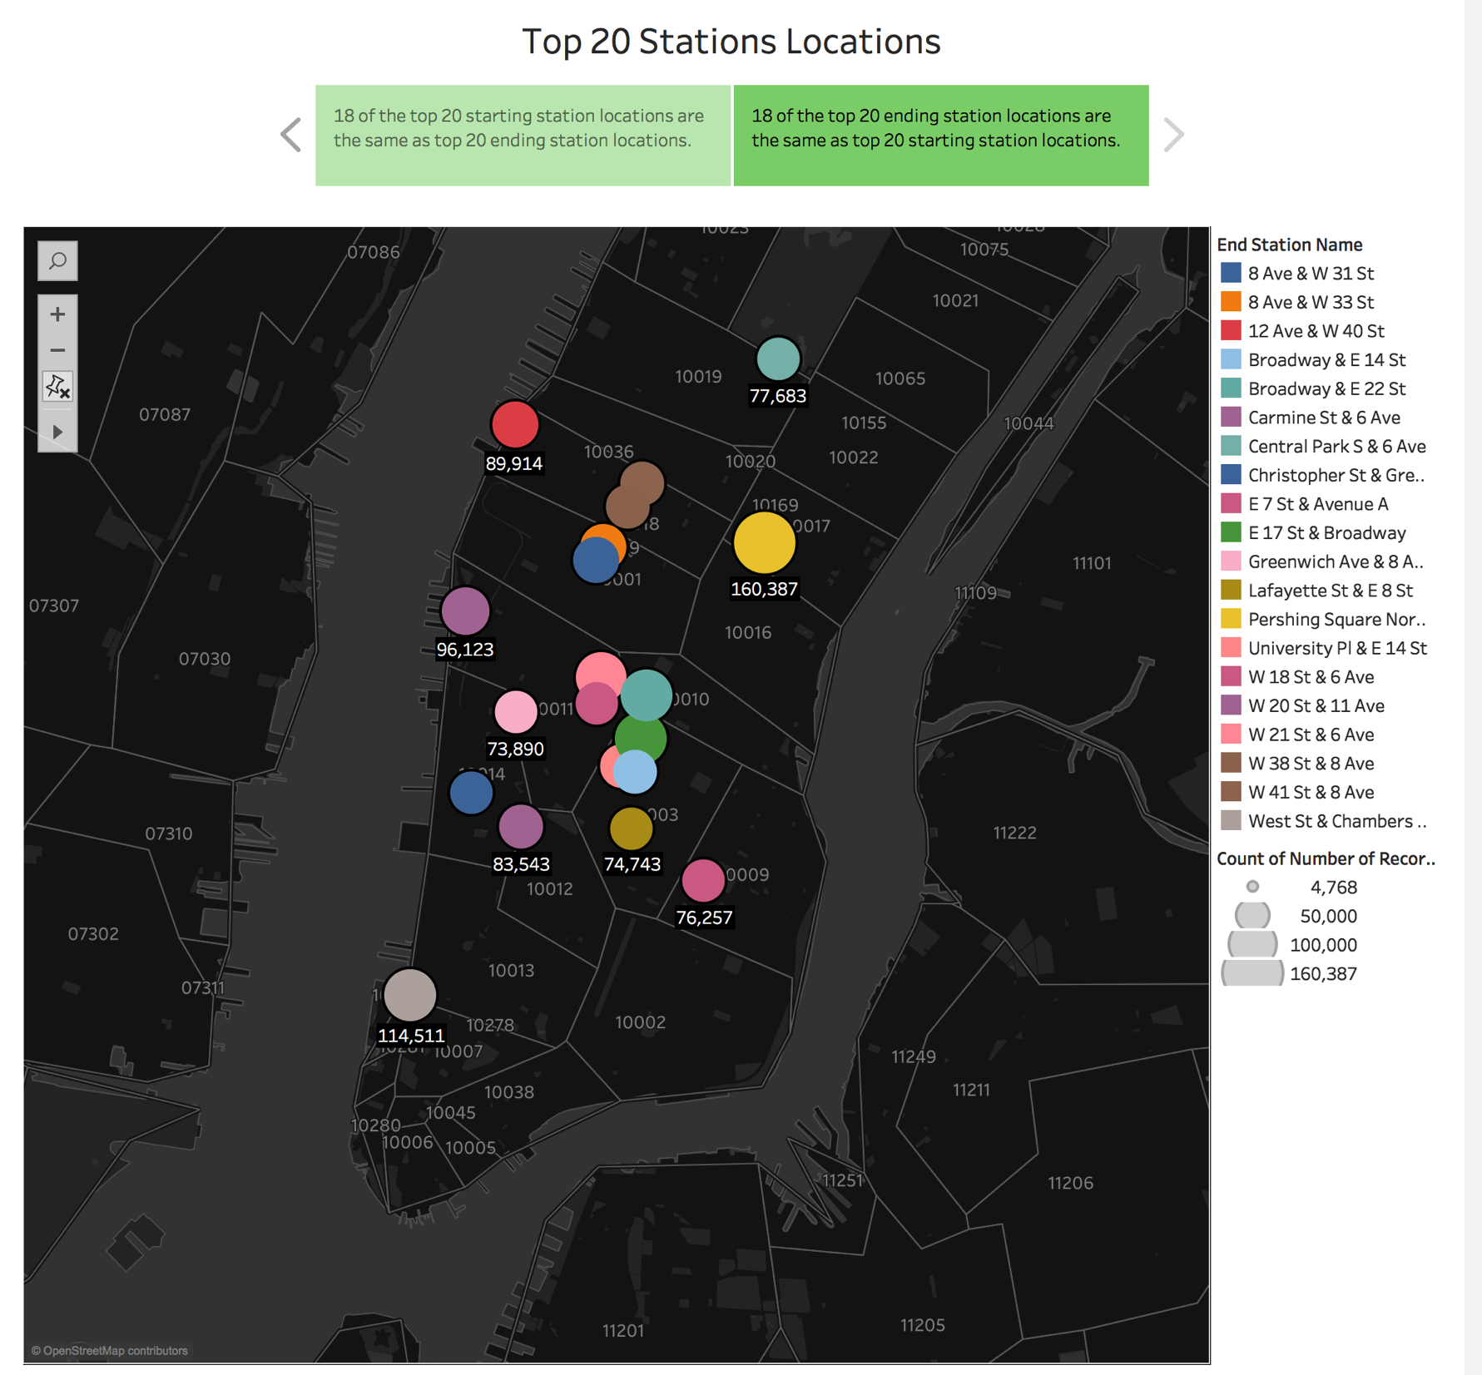
SDSD

Slide 5
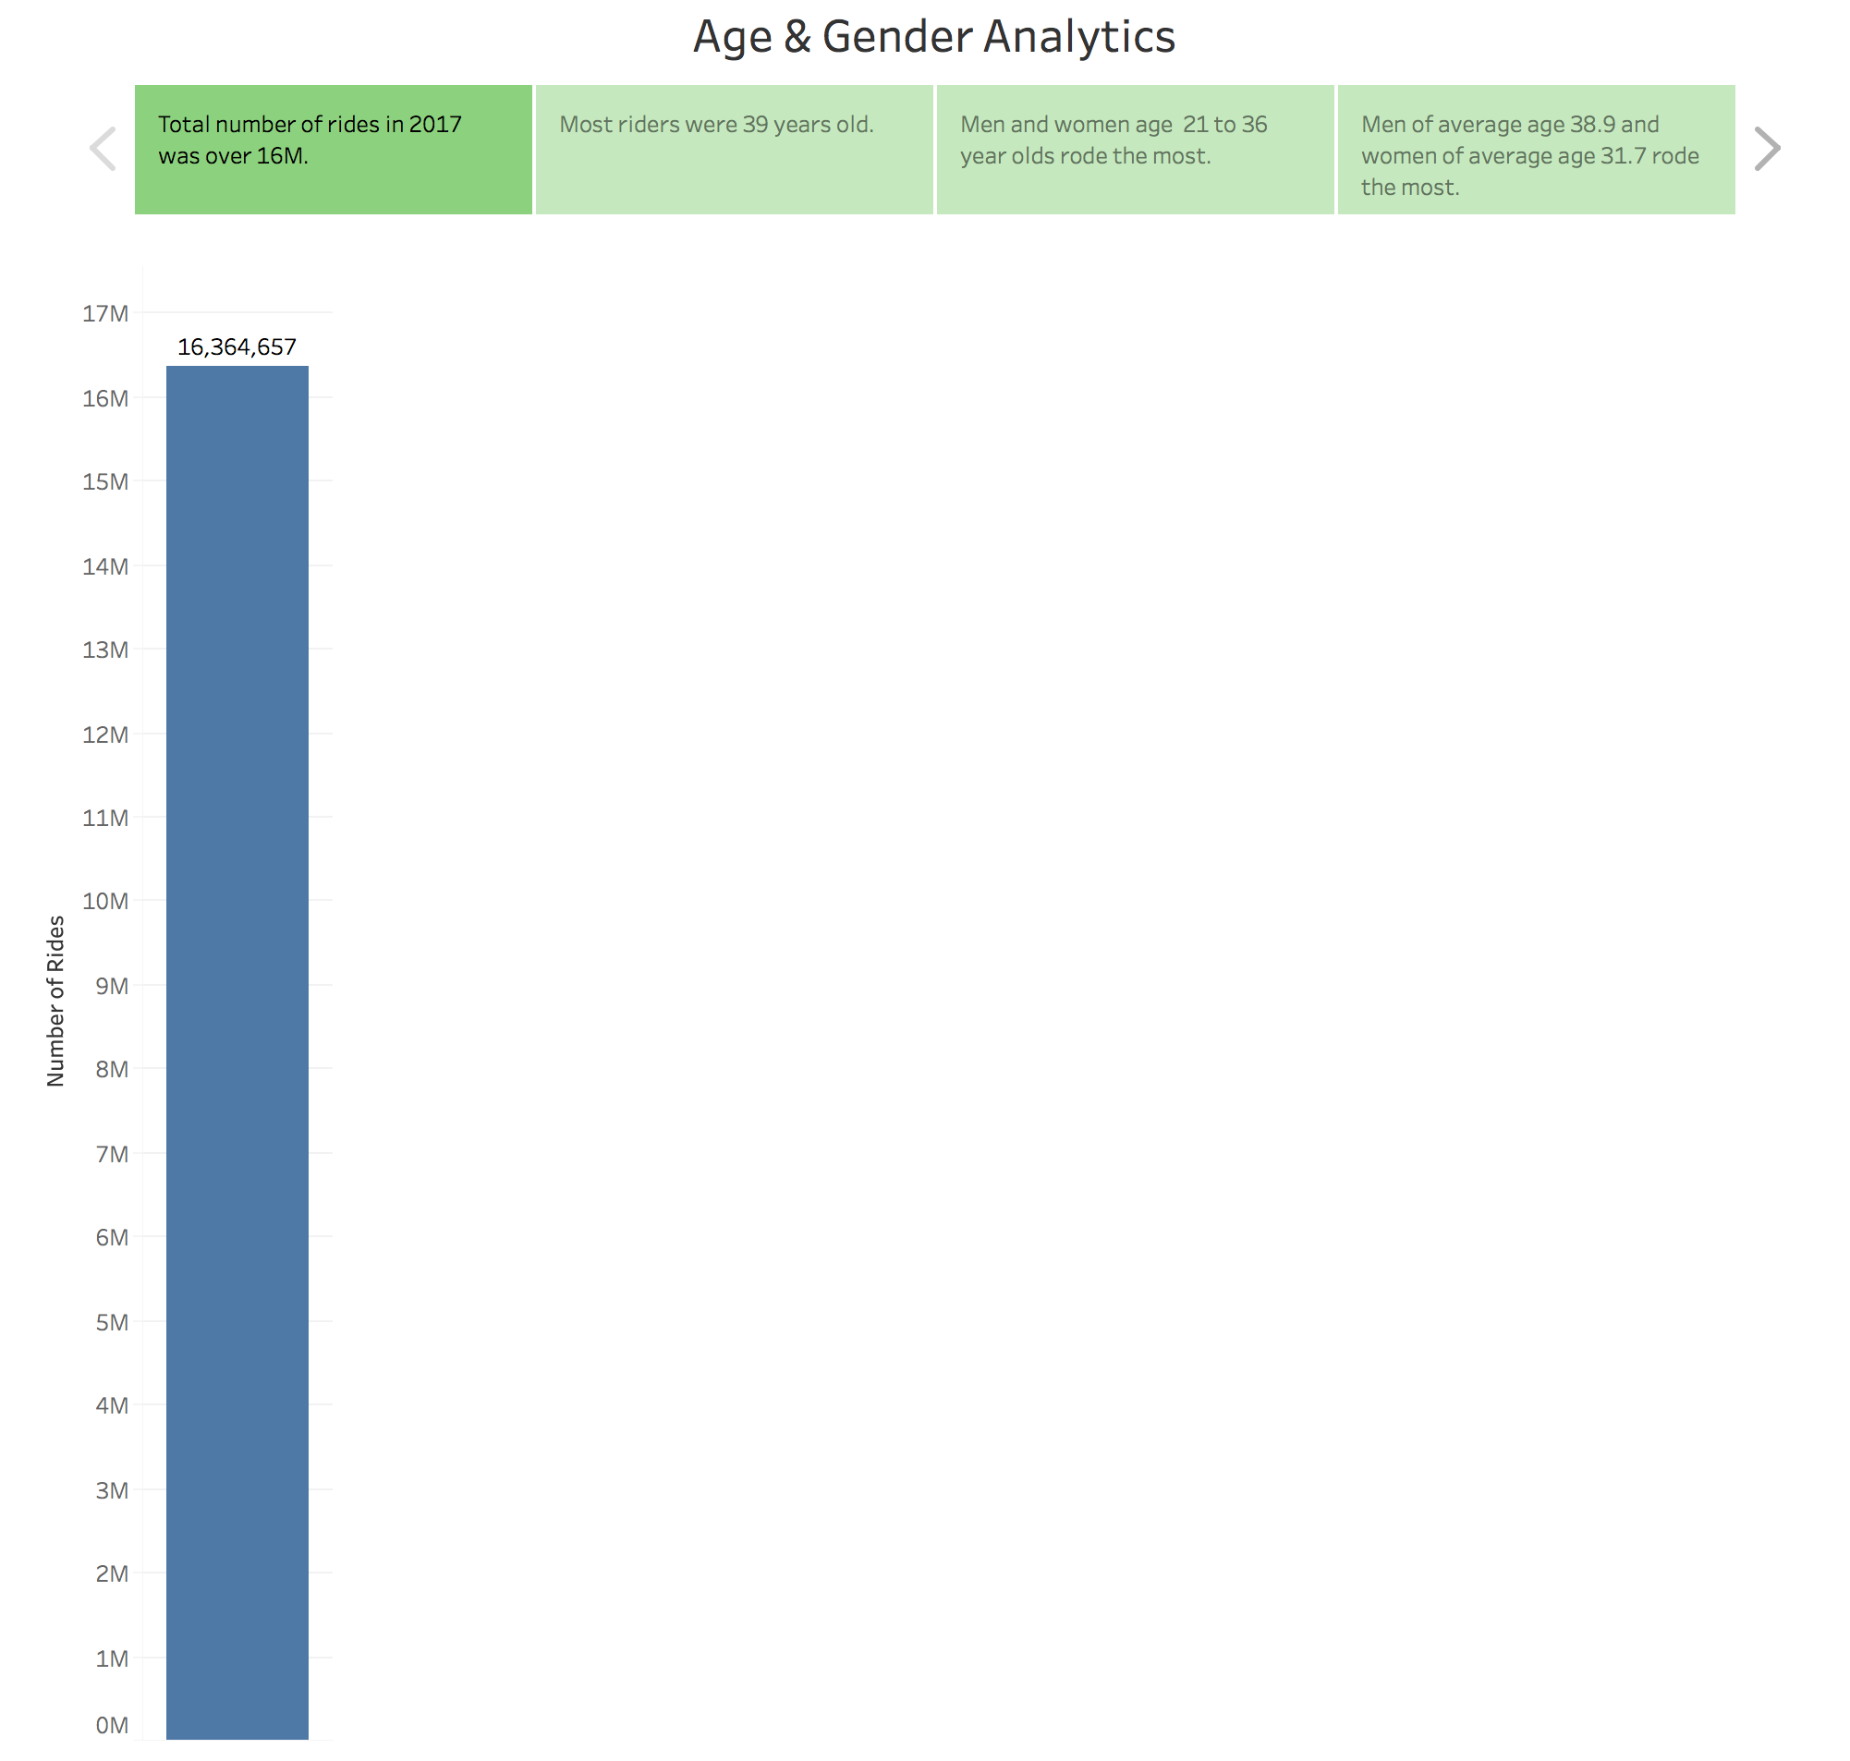

Slide 6
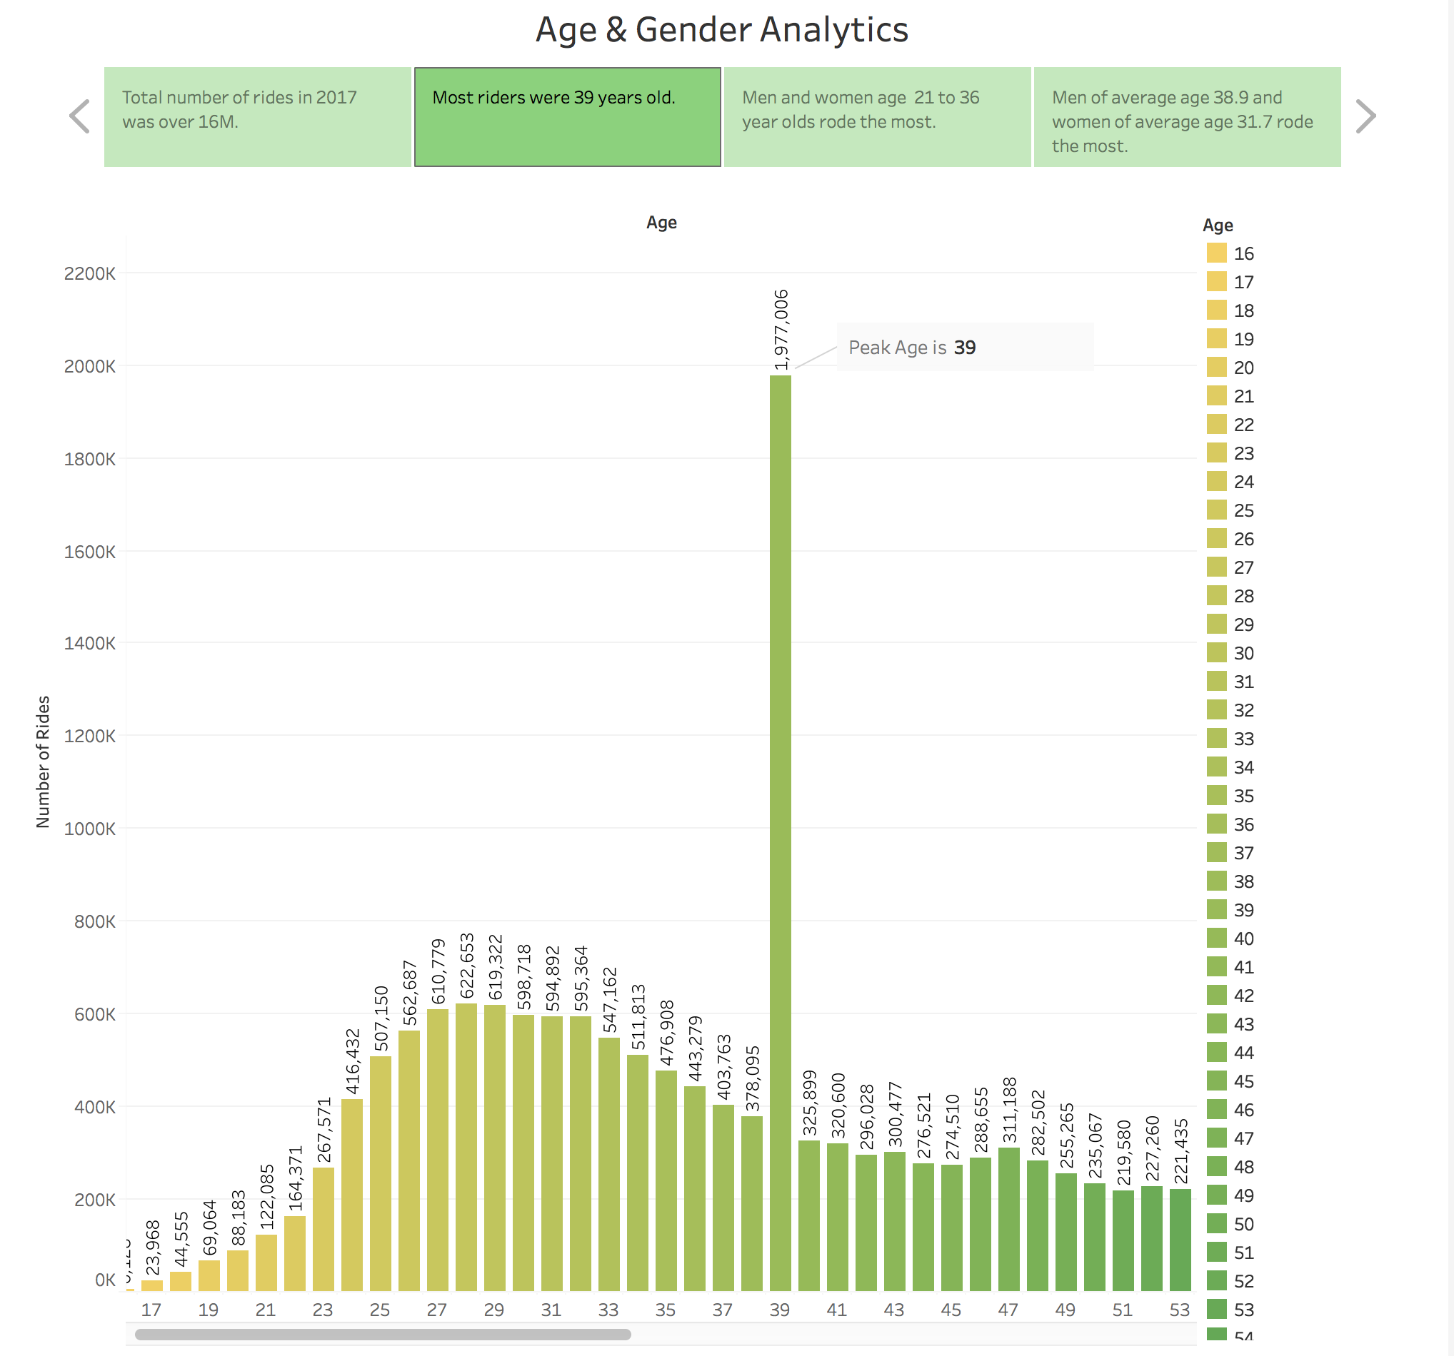

Slide 7
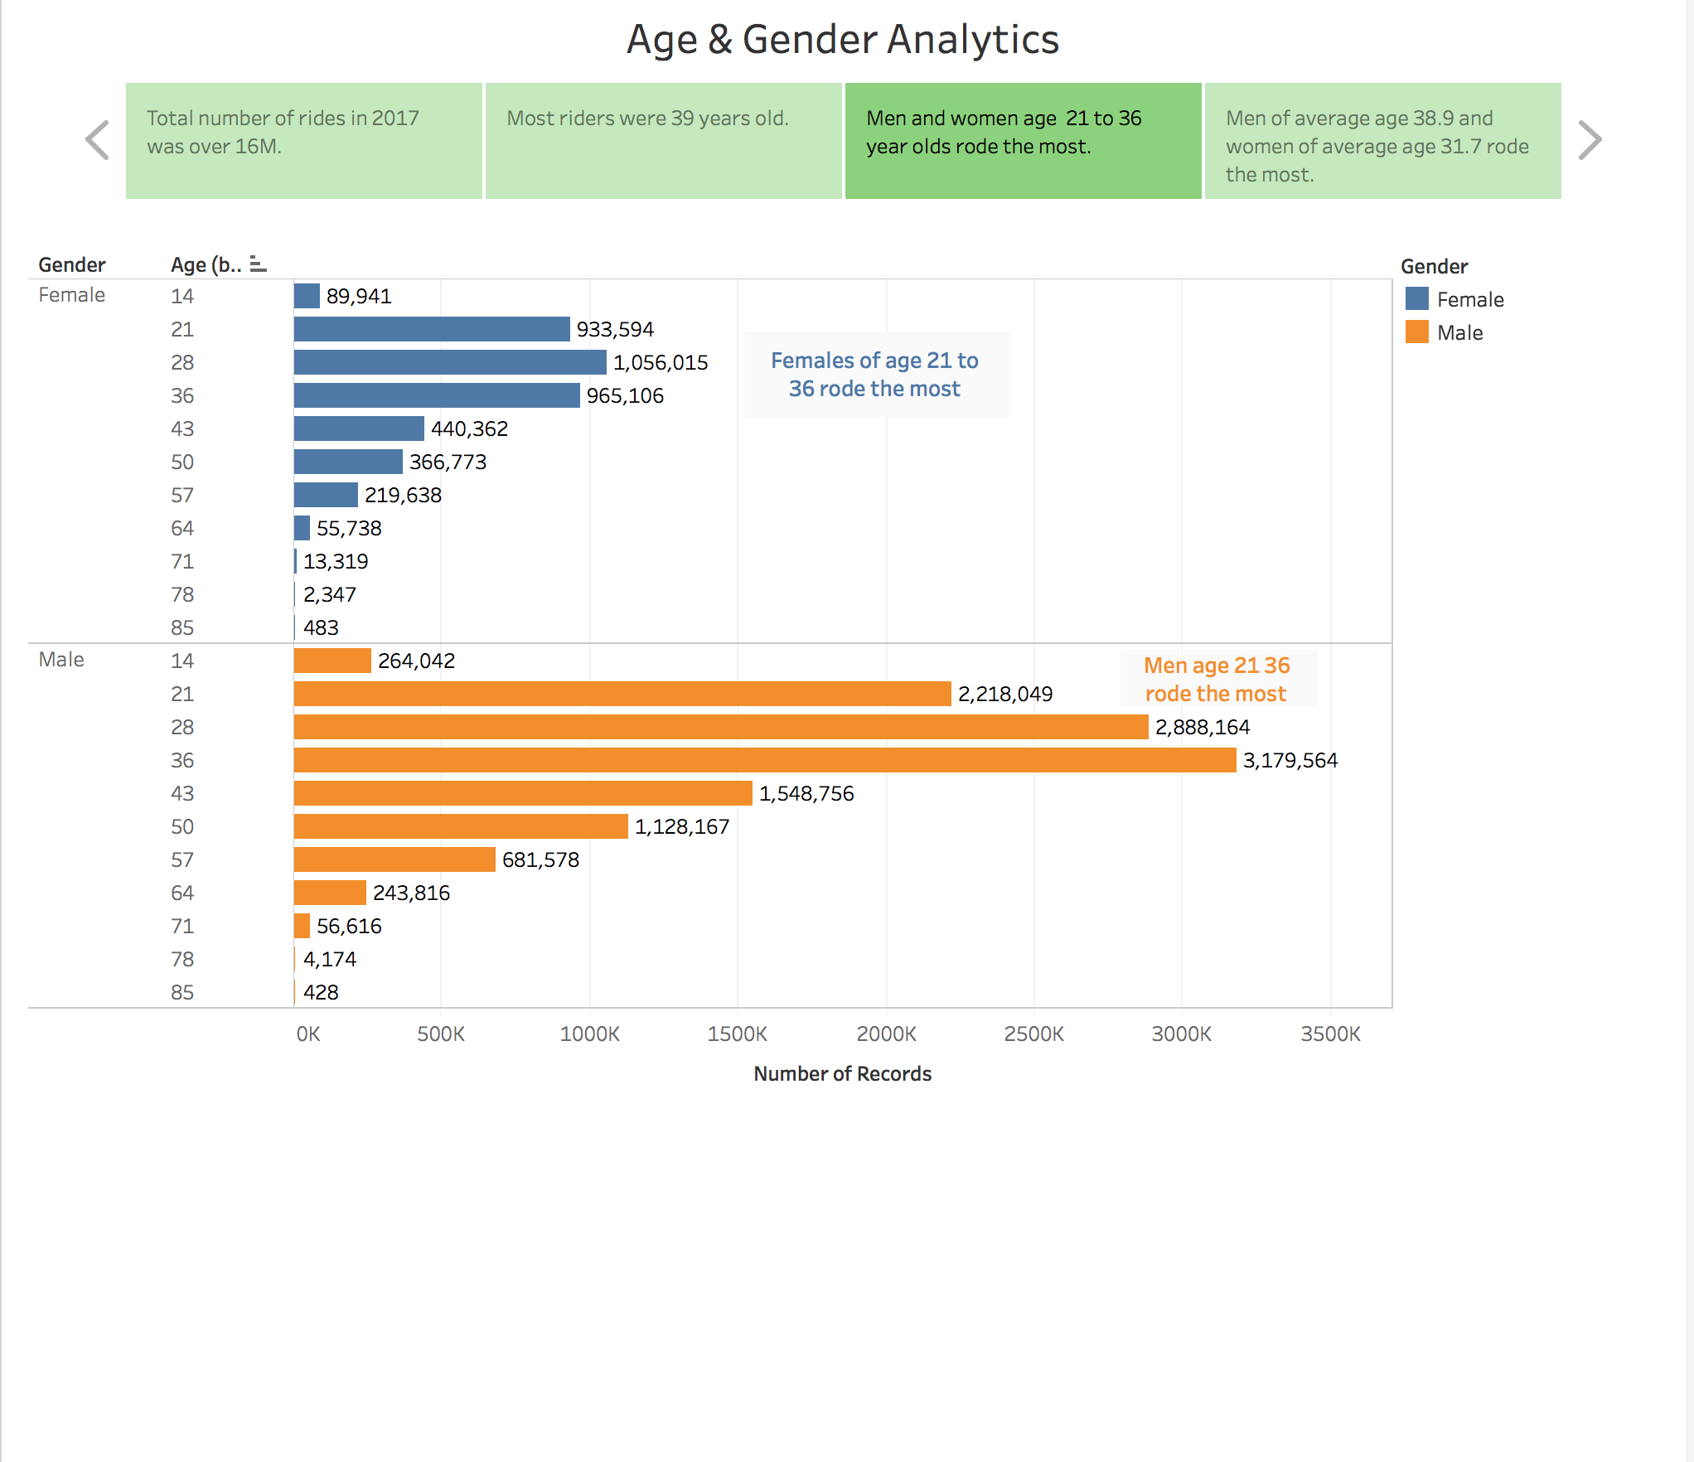

Slide 8
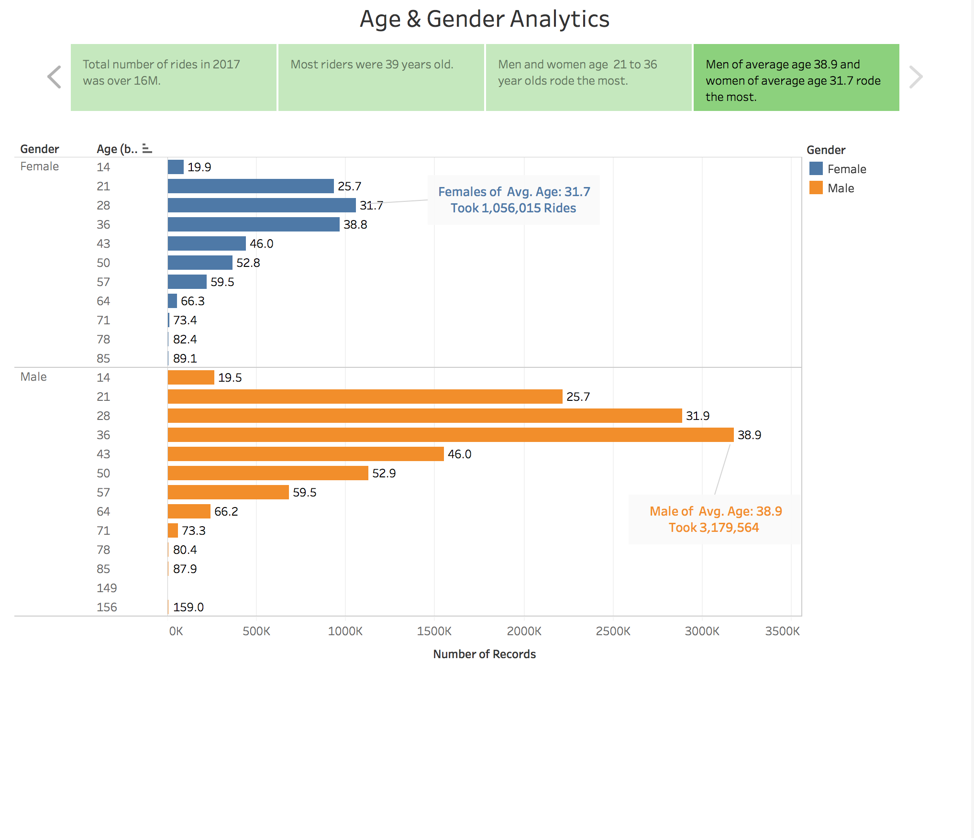

Slide 9
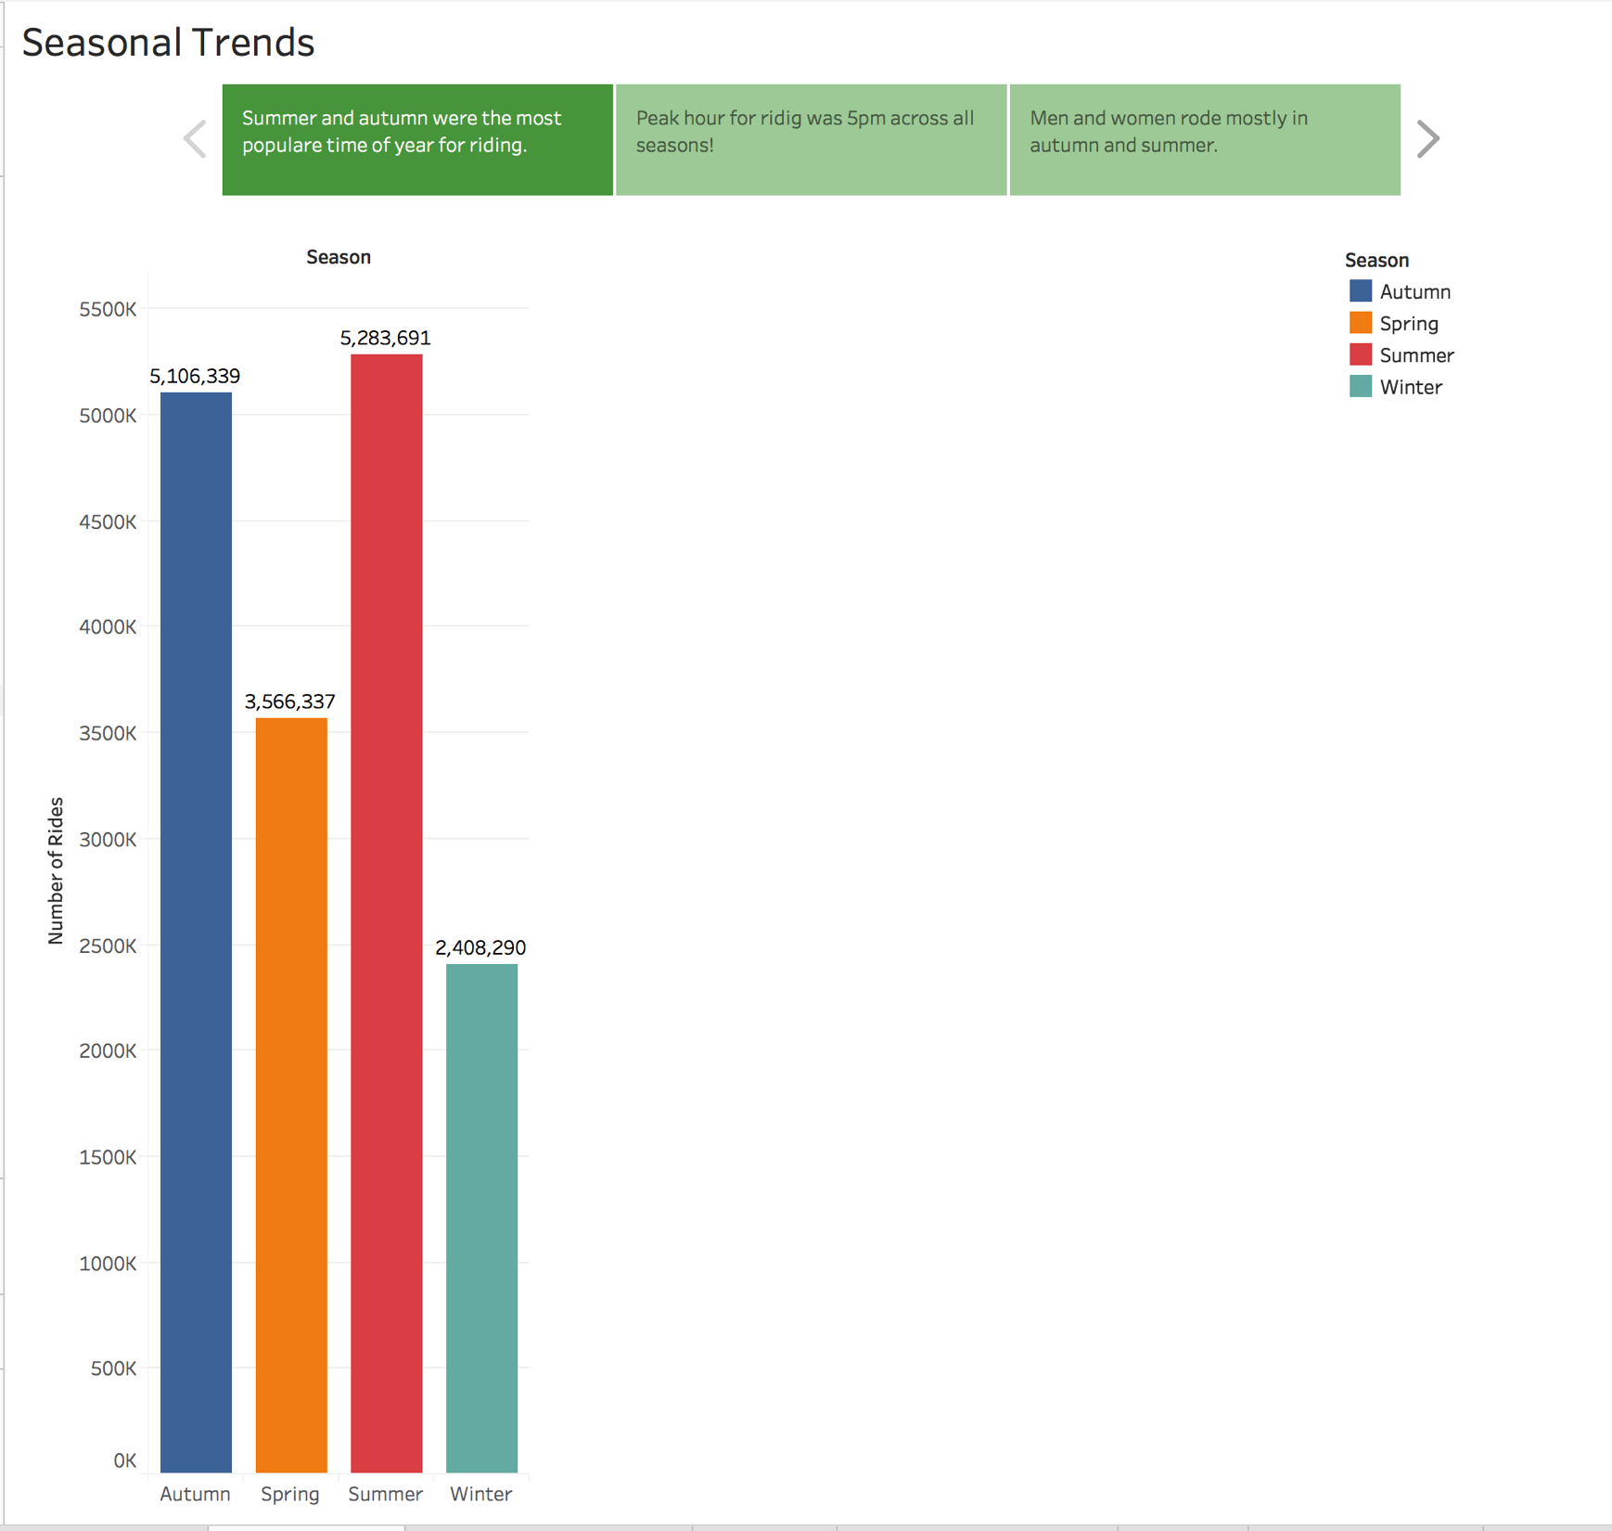

Slide 10
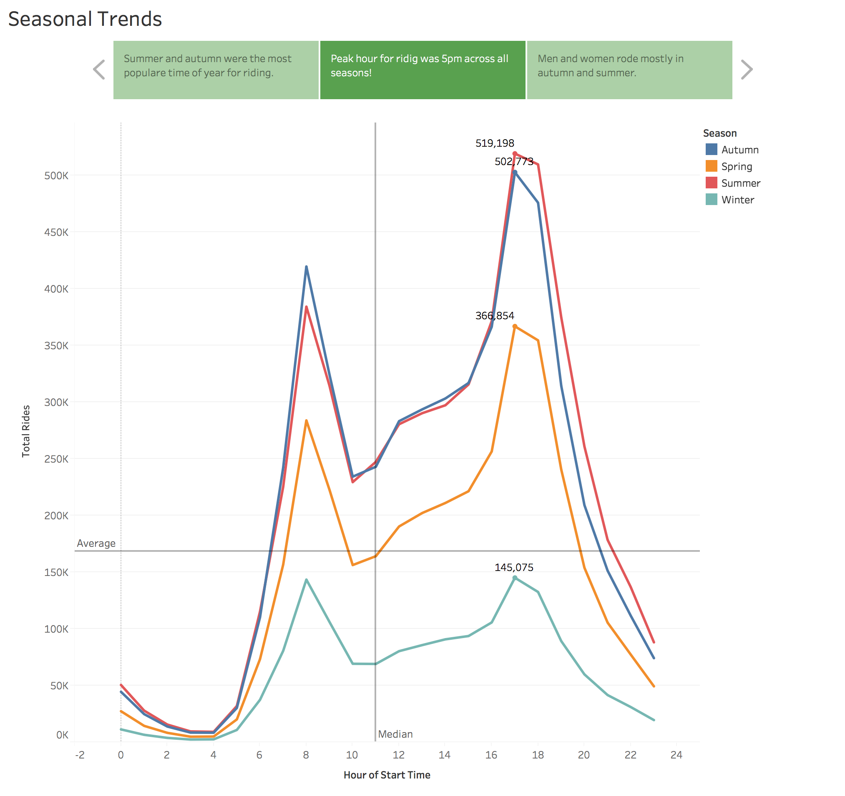

Slide 11
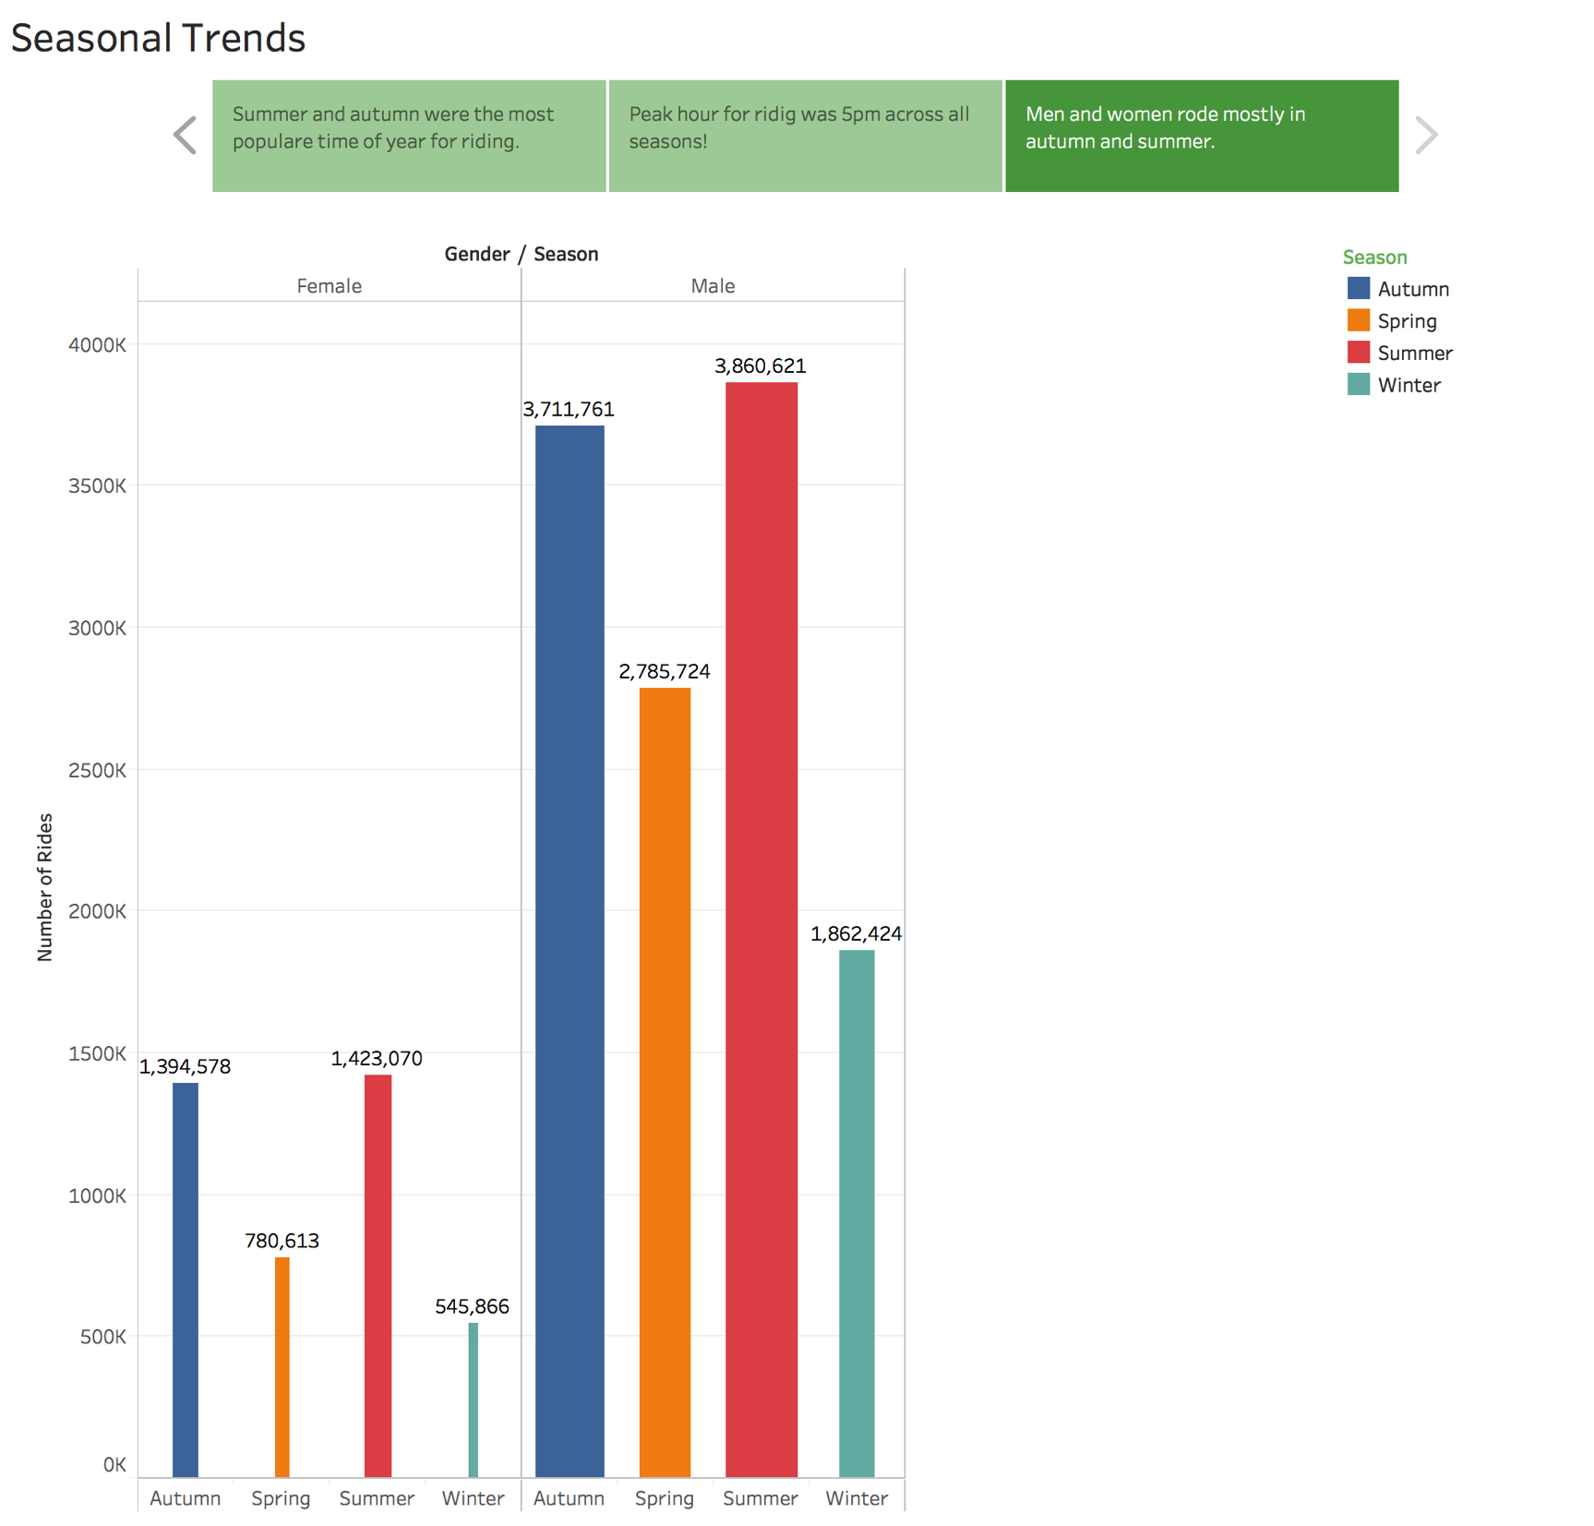

Slide 12
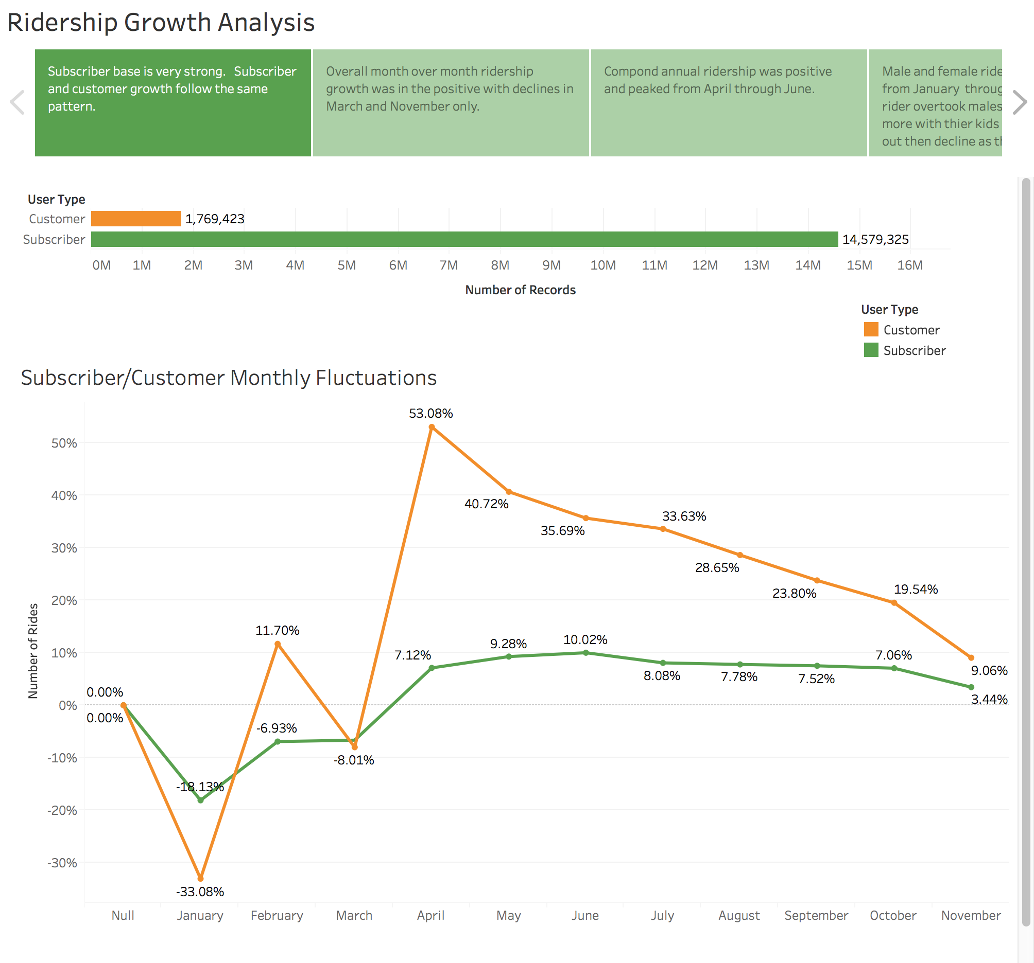

Slide 13
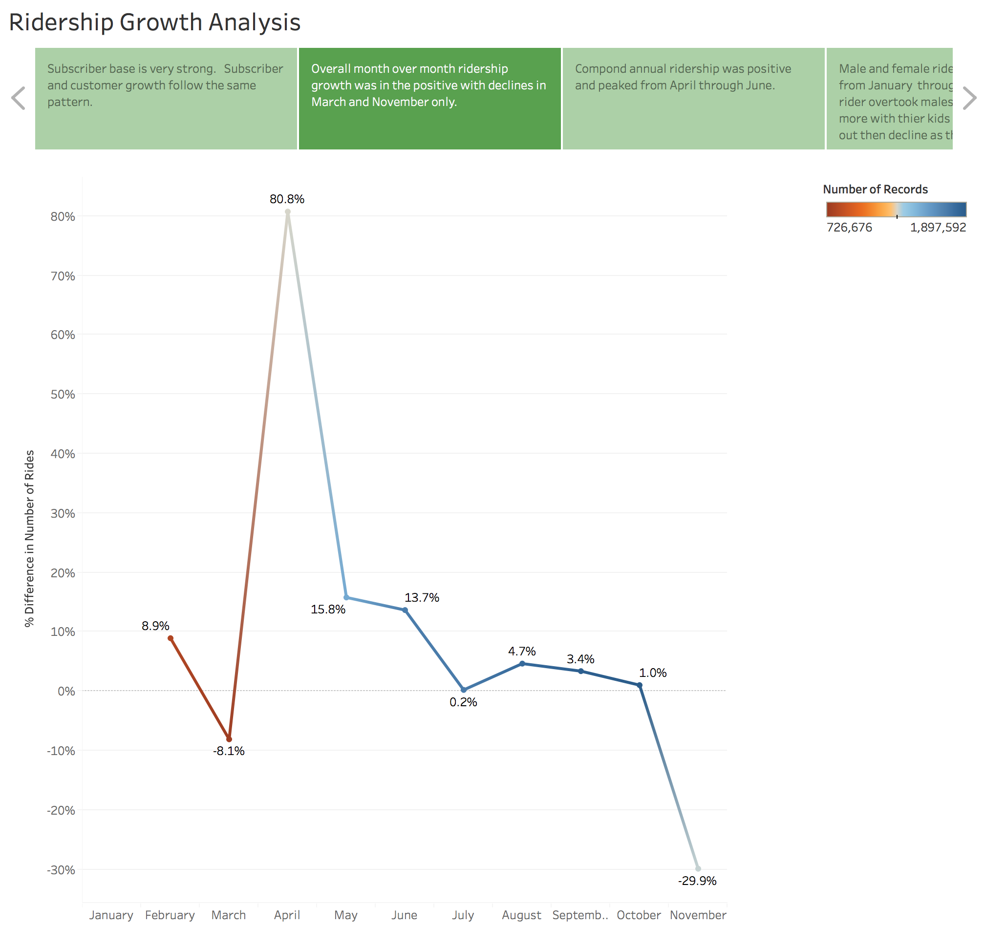

Slide 14
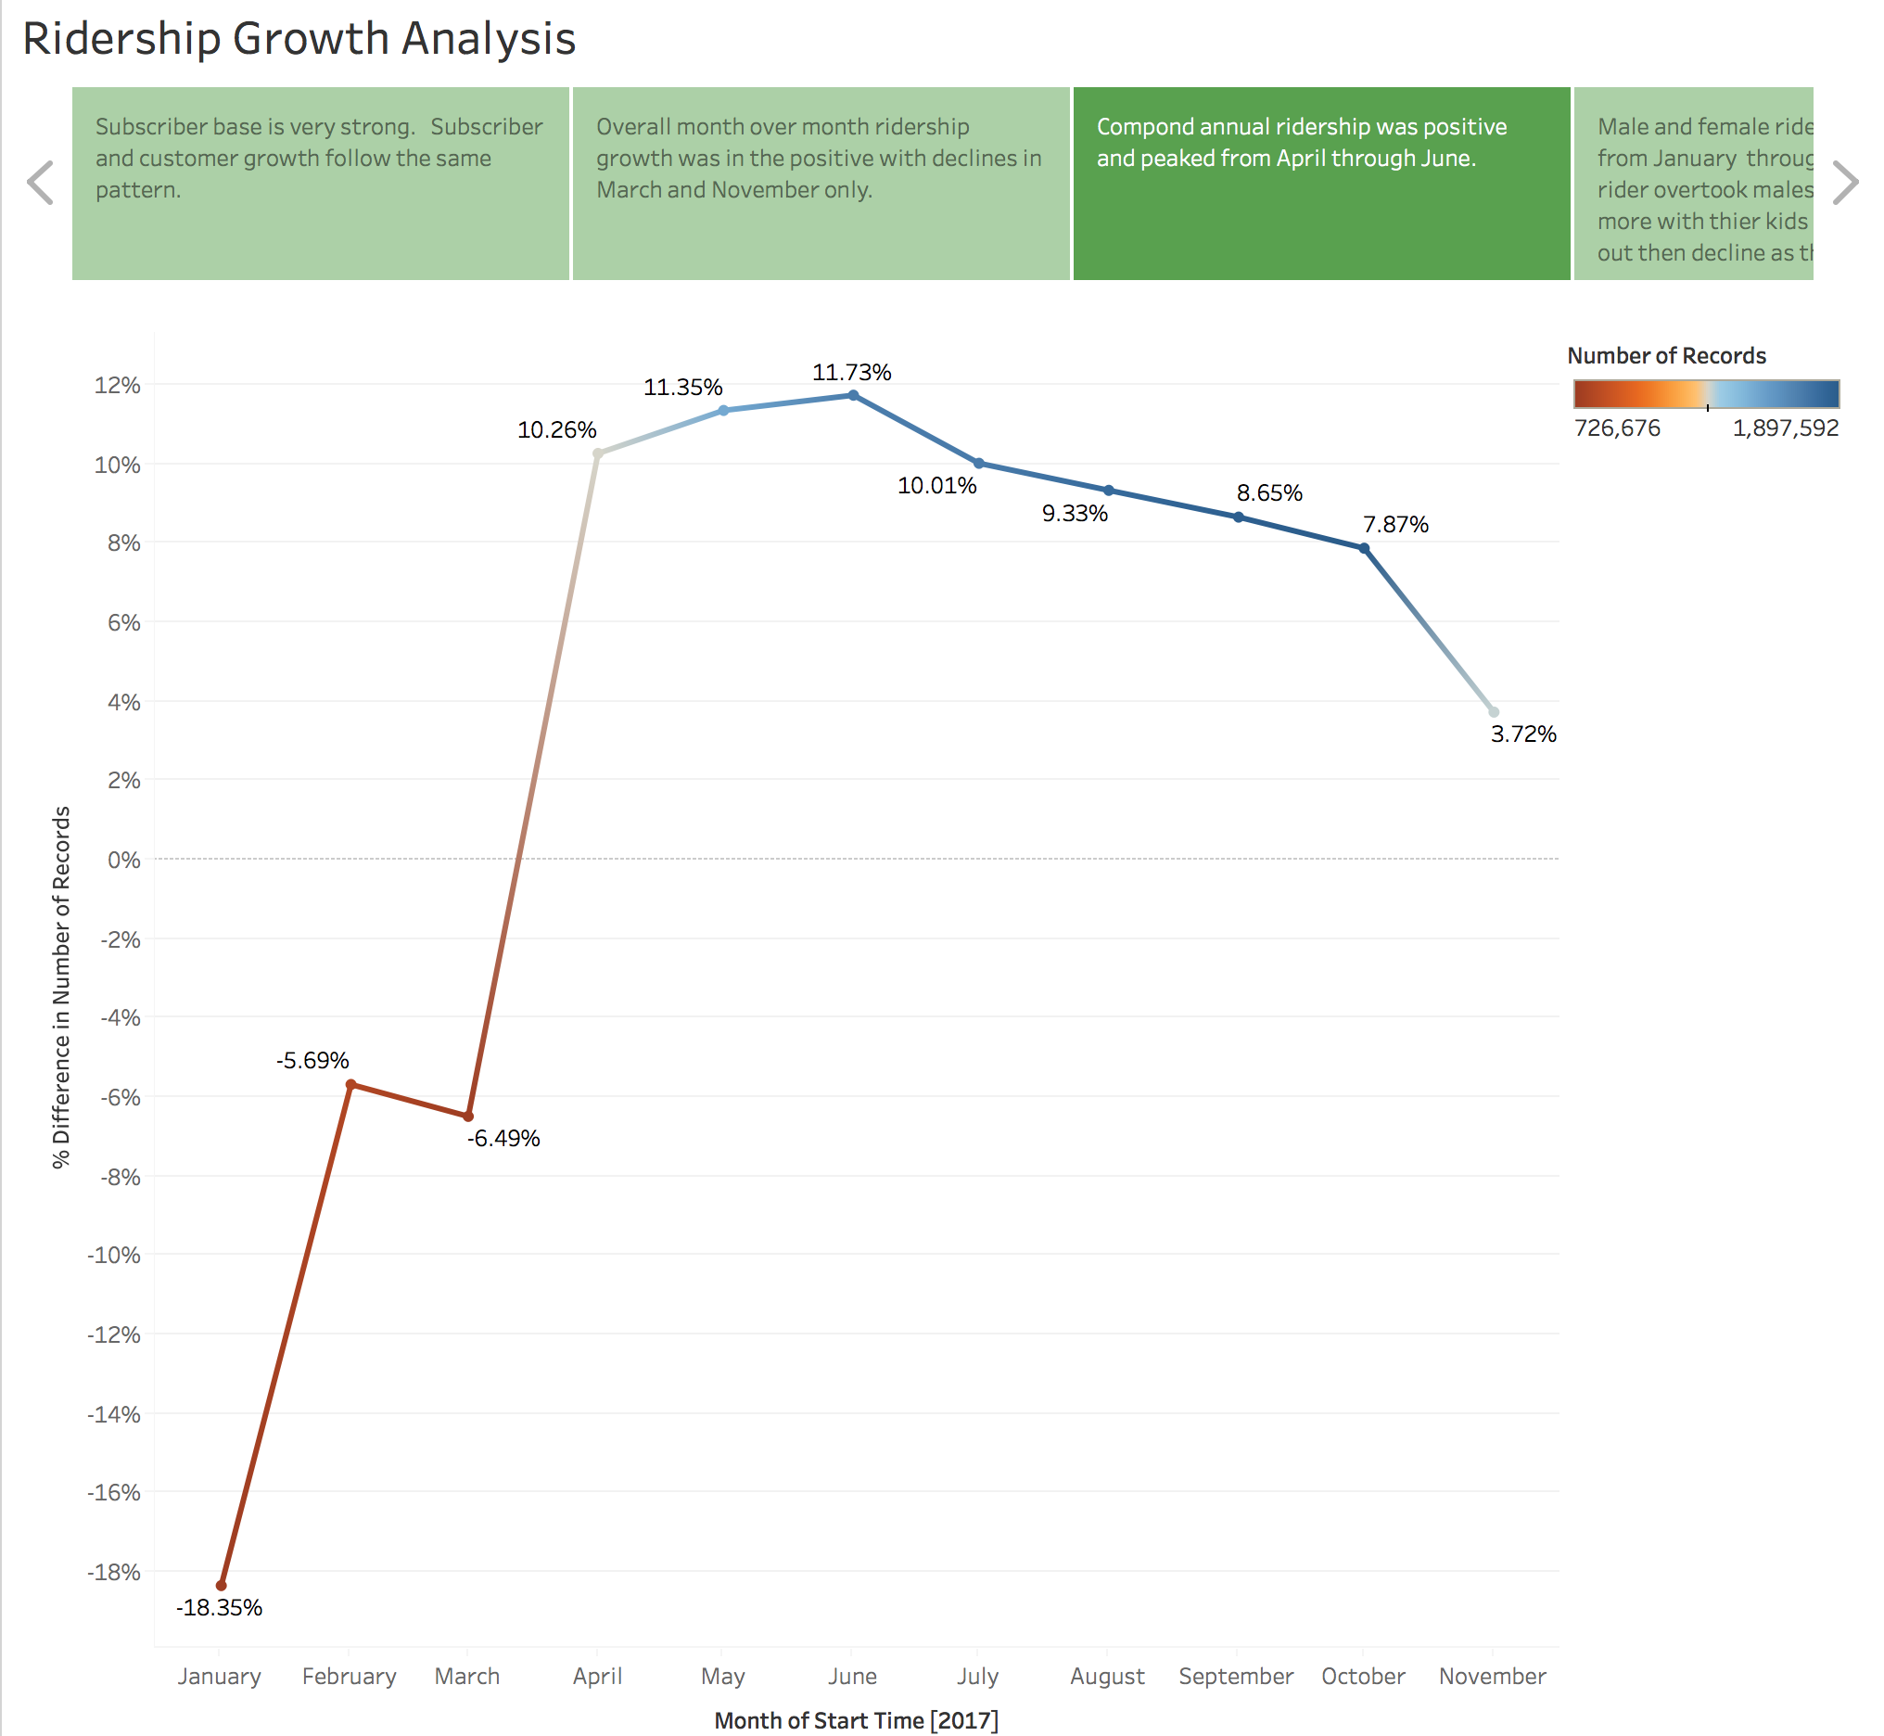

Slide 15
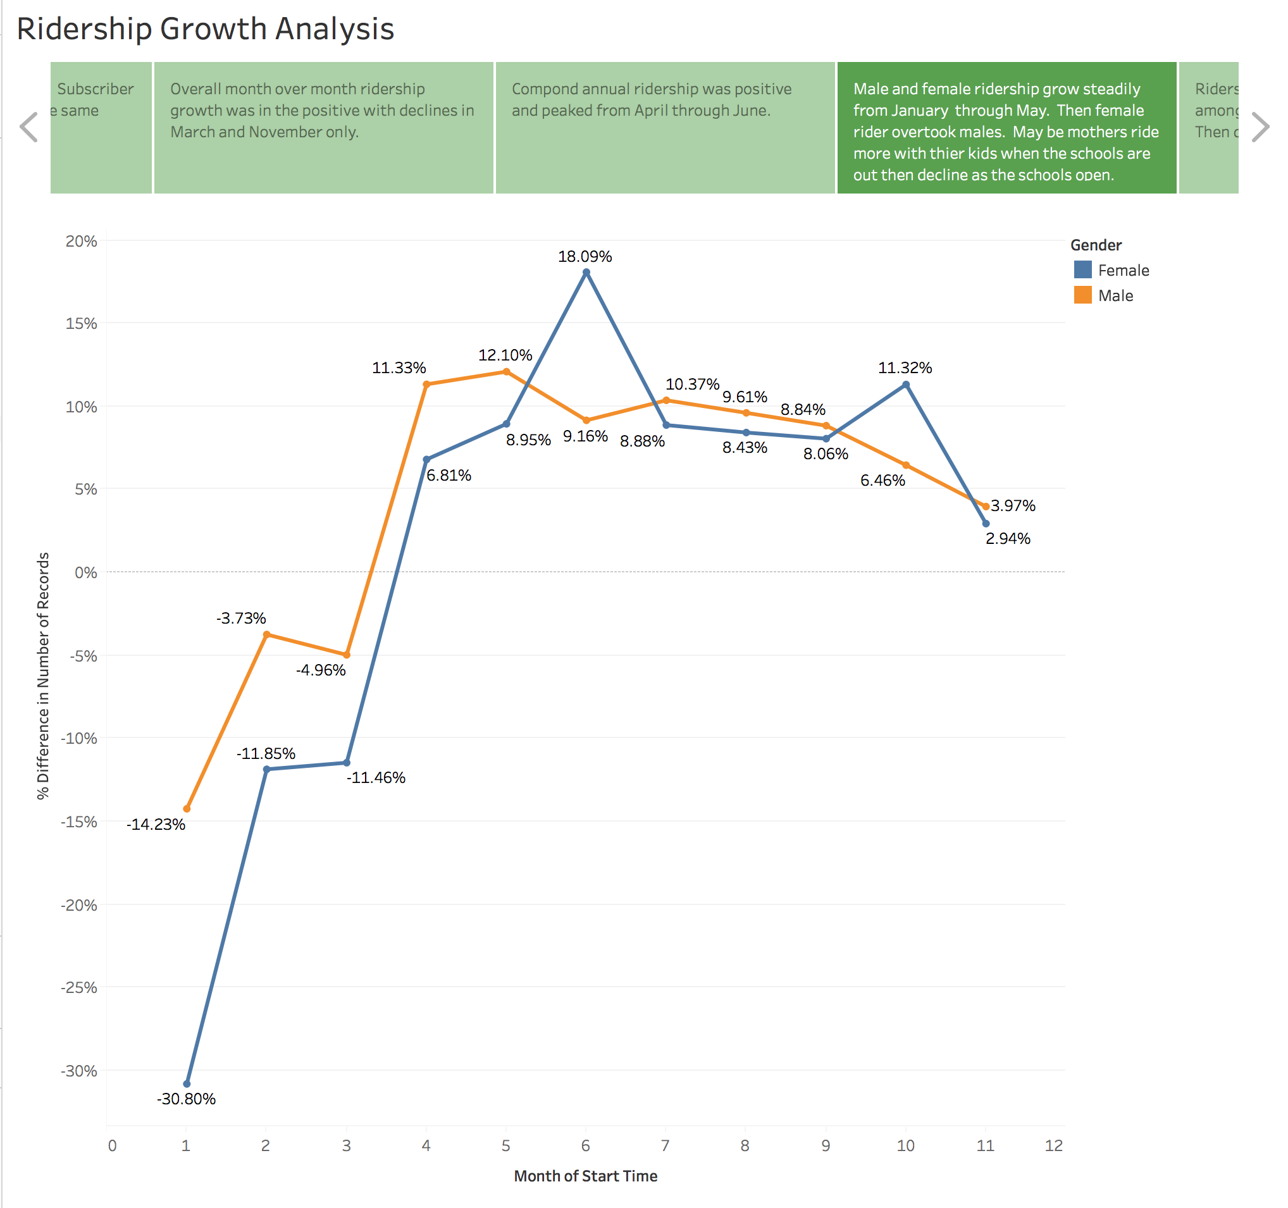

Slide 16
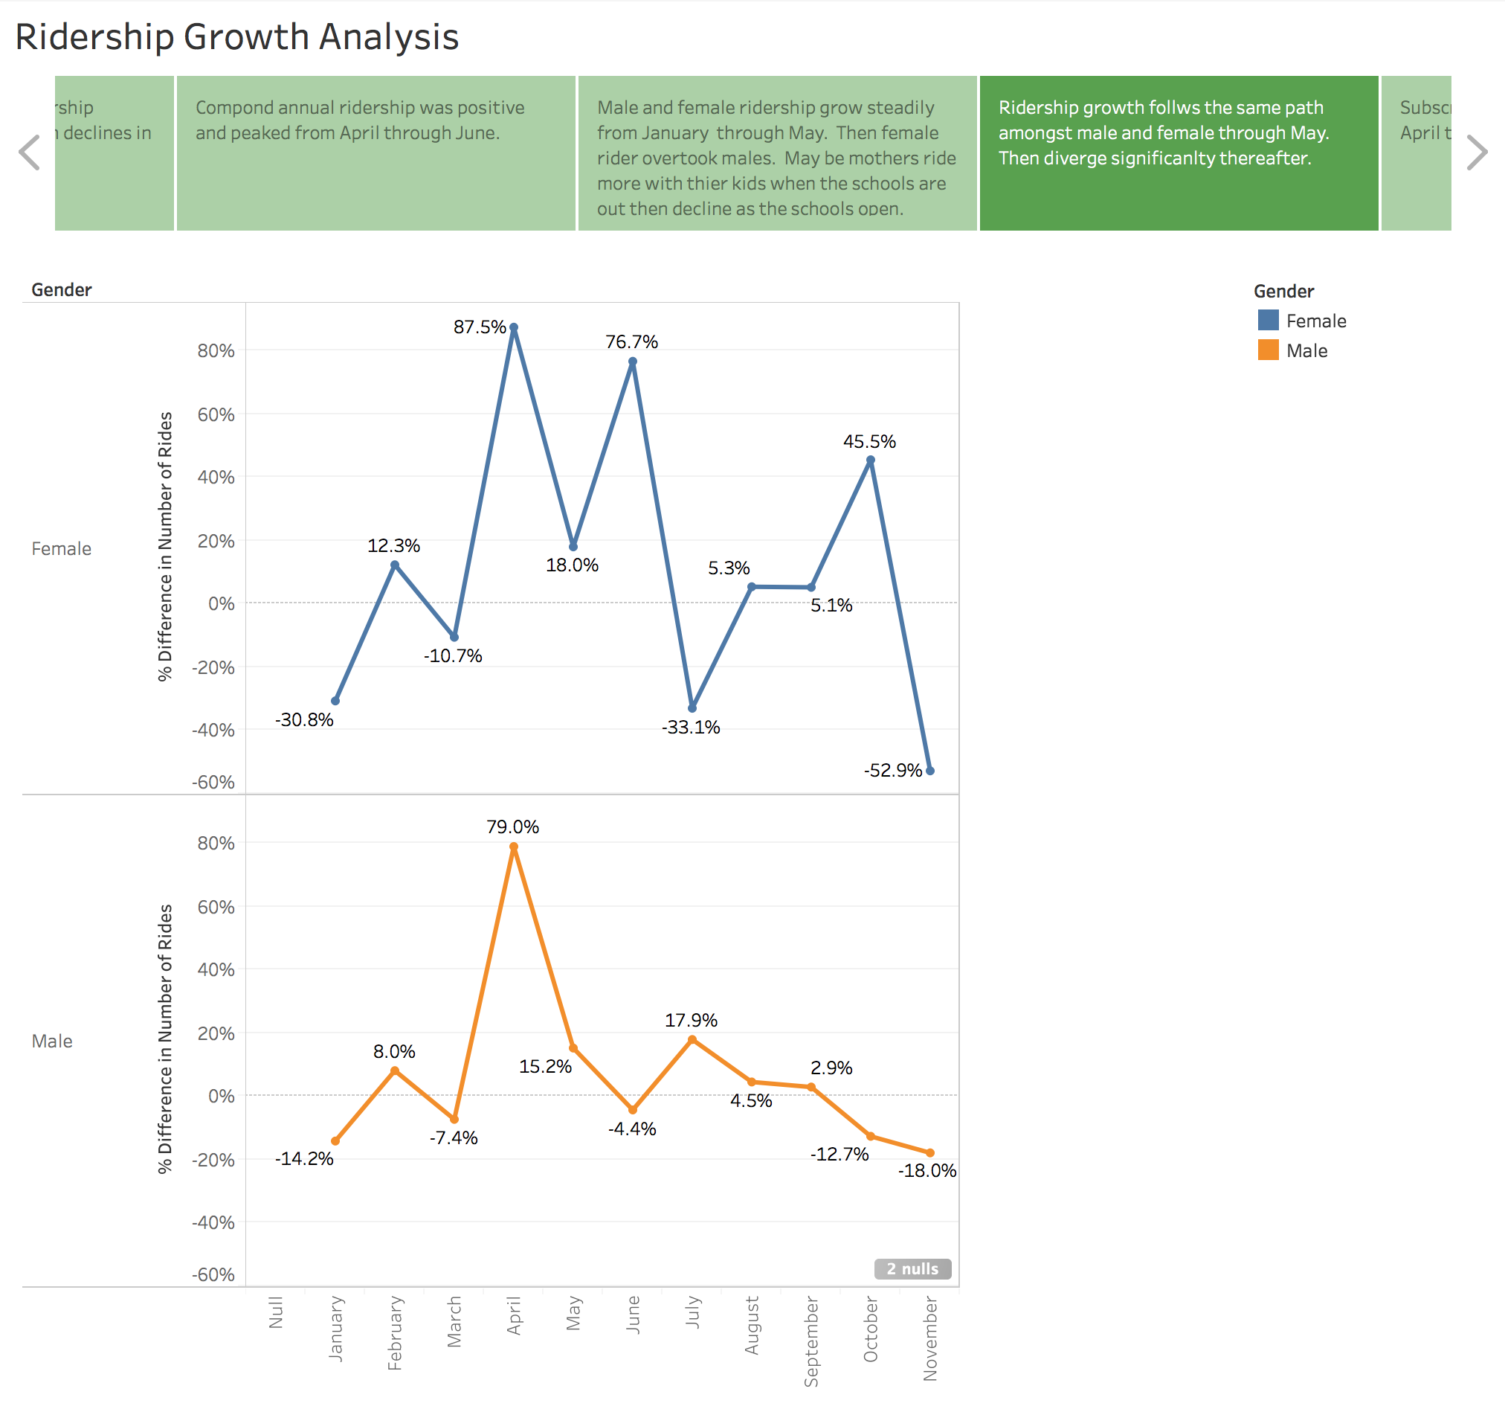

Slide 17
